Slide 1
Online Bus Booking Ticket Application
Your Ultimate Bus Travel Companion

Slide 2
Introduction
The Online Bus Ticket Booking Application is a comprehensive system that allows users to book bus tickets online, similar to platforms like RedBus.
The application provides features such as user registration, login, searching for buses, booking tickets, and processing payments. It is developed using Angular for the frontend and Spring Boot for the backend, and efficient user experience.

Slide 3
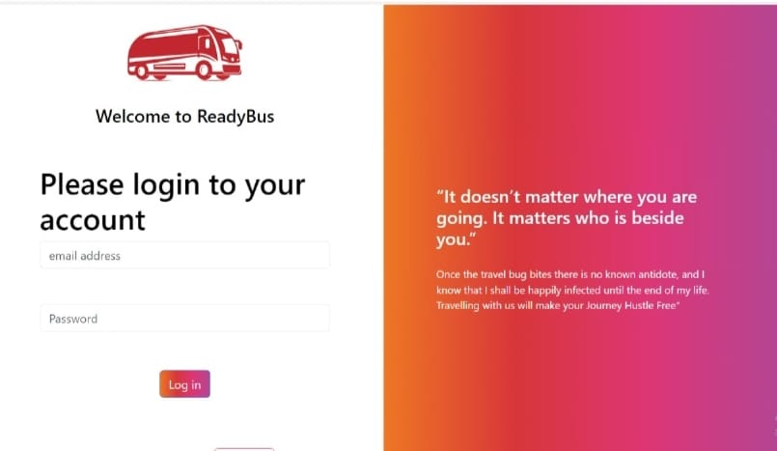
Login Page Title: User Login
Users can log in using their registered email and password.
Provides a secure and seamless login experience.

Slide 4
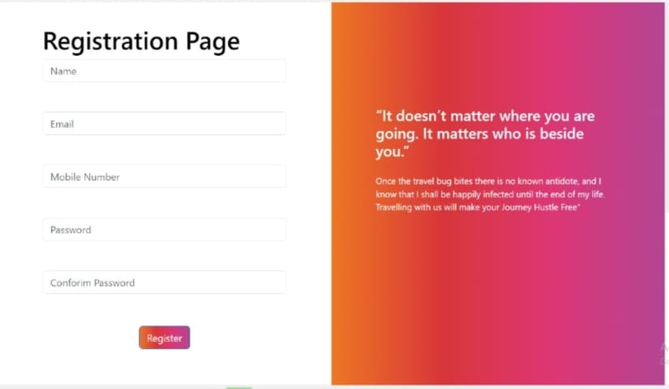
Registration Page Title: User Registration
New users can create an account by providing their details such as name, email, password, and contact information.
Ensures user data is securely stored and validated.

Slide 5
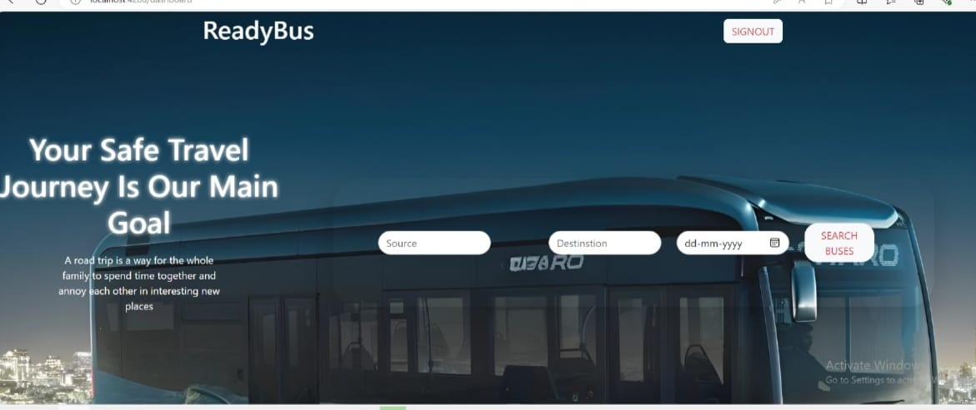
Search Buses Title: Search for Buses
Users can search for buses by entering their travel route like Source, Destination, date.
The search results display available buses, including details like departure, Duration, arrival time, and Price.

Slide 6
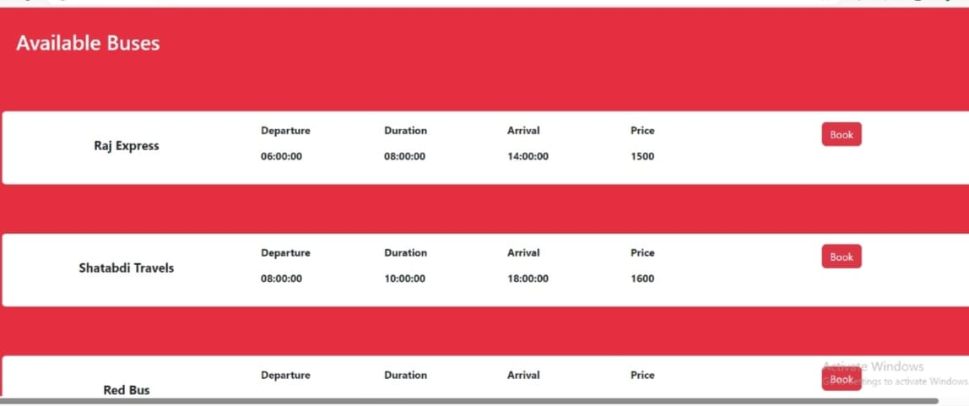
Booking Page Title: Booking a Bus Ticket
Users can search for buses based on their travel route and dates.
The booking page displays available buses, Arrival Time, and pricing.
Users can select their preferred bus and proceed with booking and payment.

Slide 7
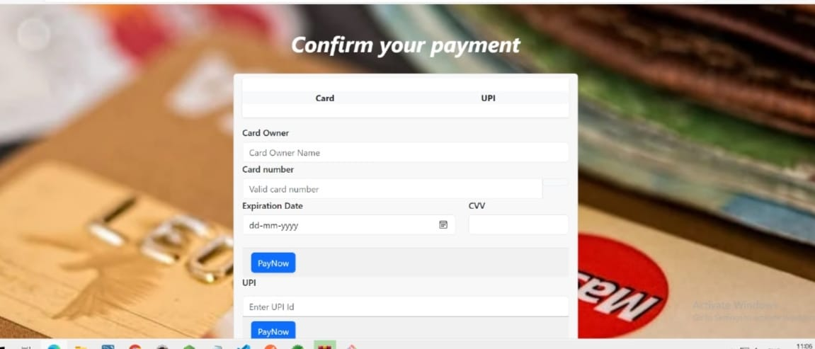
Payment Page Title: Payment Options
After booking a ticket, users can proceed to the payment page.
The payment page provides various options, including credit/debit card, net banking, and wallets.
Users enter their payment details securely, and the system processes the payment.

Slide 8
Project Team
Team Lead: [Amar Kolhe]
Frontend Developer: [Dasari Vinay Goud, Pranathi Cheripally, Aravind Naidu Amara]
Backend Developer: [Ashish Kumar Arya, Amar Kolhe]
Database Administrator: [Ashish Kumar Arya, Amar Kolhe]
Unit Testing: [Aravind Naidu Amara, Amar Kolhe]

Slide 9
Thank You

